Slide 1
Relational Database Design
Unit - 3

Slide 2
Database Design
First characterize fully the data requirements of the prospective database users, which usually involves in textual descriptions (Requirement Analysis).
Next, choose ER model to translate these requirements into a conceptual schema of the database.
In the logical design phase, map the high level conceptual schema onto the implementation data model of the database system that will be used. The implementation data model is typically the Relational data model.
Finally, use the resulting system specific database schema in the subsequent physical design phase, in which the physical features of the database are specified.
In designing a database schema, the major pitfalls which should be avoided are:
Redundancy: It means repetition of the information.
Incompleteness: It means certain aspects of the enterprise may not be modeled due to difficulty or complexity

Slide 3
Problems encountered with bad schema designs
Bad Database Design/Concept of Anomalies
Insertion Anomaly
Updation Anomaly
Deletion Anomaly

Slide 4
Bad Database Design/Concept of Anomalies
Database anomalies are the problems in relations that occur due to redundancy in the relations. These anomalies affect the process of inserting, deleting and updating data in the relations.
The intension of relational database theory is to eliminate anomalies from occurring in a database.
Name | Course | Phone_no | Major | Prof | Grade
Mahesh | 353 | 1234 | Comp sc | Alok | A
Nitish | 329 | 2435 | Chemistry | Pratap | B
Mahesh | 328 | 1234 | Comp sc | Samuel | B
Harish | 456 | 4665 | Physics | James | A
Pranshu | 293 | 4437 | Decision sc | Sachin | C
Prateek | 491 | 8788 | Math | Saurav | B
Prateek | 356 | 8788 | Math | Sunil | In prog
Mahesh | 492 | 1234 | Comp sc | Paresh | In prog
Sumit | 379 | 4575 | English | Rakesh | C

Slide 5
Bad Database Design/Concept of Anomalies
Insertion Anomaly: It is the anomaly in which the user cannot insert a fact about an entity until he/she has an additional fact about another entity. In other words, there are circumstances in which certain facts can not be recorded at all.
Ex: We cannot record a new prof details without assigning a course to him.

Slide 6
Deletion Anomaly: It is the anomaly in which the deletion of facts about an entity automatically deleted the fact of another entity.
Ex: If we want to delete the information about course 293, automatically the information of prof Sachin will be deleted which is not our interest.
Updation Anomaly: It is the anomaly in which the modification in the value of specific attribute requires modification in all records in which that value occurs. In other words, the same data can be expressed in multiple rows. Therefore, updates to the table may result in logical inconsistencies.
Ex: If the updation to the phone_no of Mahesh is done in a single row only, then the updation process will put the database in an inconsistent state so that the phone_no of Mahesh will give conflicting answers.

Slide 7
Functional Dependency (FD)
Functional Dependency is the building block of normalization principles.
Functional dependency (FD) is a set of constraints between two attributes in a relation. Functional dependency says that if two tuples have same values for attributes A1, A2,..., An, then those two tuples must have to have same values for attributes B1, B2, ..., Bn.
In other words, the value of attribute A uniquely determines the value of attribute B and if there were several tuples that had the same value of A then all these tuples will have an identical value of attribute B. That is, if t1 and t2 are two tuples in the relation R where t1(A) = t2(A), then we must have t1(B) = t2(B).
The functional dependency is a relationship that exists between two attributes. It typically exists between the primary key and non-key attribute within a table.
Functional dependency is represented by an arrow sign (→) that is, X→Y, where X functionally determines Y. The left-hand side attributes determine the values of attributes on the right-hand side.

Slide 8
Functional Dependency (FD)
Example:
Suppose we have a student table with attributes: Stu_Id, Stu_Name, Stu_Age.
Here Stu_Id attribute uniquely identifies the Stu_Name attribute of student table because if we know the student id we can tell the student name associated with it.
This is known as functional dependency and can be written as
Stu_Id ->Stu_Name
or in words we can say Stu_Name is functionally dependent on Stu_Id..

Slide 9
Functional Dependency (FD)
Advantages of Functional Dependency
Functional Dependency avoids data redundancy where same data should not be repeated at multiple locations in same database.
It maintains the quality of data in database.
It allows clearly defined meanings and constraints of databases.
It helps in identifying bad designs.
It expresses the facts about the database design.

Slide 10
Functional Dependency (FD)
Testing of Functional Dependency: (FD Holds Good or NOT)
A -> BC (holds Good)
DE ->C (Holds good)
C -> DE (Not holds good)
4.BC -> A (holds good)
Q. which of the above option is correct (FD holds good.)
A | B | C | D | E
a | 2 | 3 | 4 | 5
2 | a | 3 | 4 | 5
a | 2 | 3 | 6 | 5
a | 2 | 3 | 6 | 6

Slide 11
Functional Dependency (FD)
Testing of Functional Dependency: (FD Holds Good or NOT)
1. XY -> Z && Z->Y
2. YZ ->X && Y->Z
3. YZ ->X && X-> Z
4.XZ -> Y && Y ->Z
Q. which of the above option is correct (FD holds good.)
X | Y | Z
1 | 4 | 2
1 | 5 | 3
1 | 6 | 3
3 | 2 | 2

Slide 12
Functional Dependency (FD)
Testing of Functional Dependency: (FD Holds Good or NOT)
1. A -> B && BC -> A
2. C -> B && CA->B
3. B ->C && AB-> C
4.A -> C && BC ->A
Q. which of the above option is correct (FD holds good.)
A | B | C
1 | 2 | 4
3 | 5 | 4
3 | 7 | 2

Slide 13
Functional Dependency (FD)
Note :
We never find out Functional Dependency by the help of data.
Generally data depends upon dependency.
Steps for Checking FD: ( A -> B)
You must check the value of A , if all the values of A are unique then FD holds good.
If all values of B are same then also FD holds good.
If two same values of A , we get two different values of B , then FD doesnot holds good.

Slide 14
Types of Functional Dependency (FD)
Trivial functional dependency
non-trivial functional dependency
Multivalued dependency
Transitive dependency

Slide 15
Trivial FDs and Non-Trivial FDs
Trivial FDs:
A functional dependency X→Y is a trivial functional dependency if Y is a subset or equal of X.
The following dependencies are also trivial: A->A & B->B
For example-1, {Name, Course}→ Course. If two records have the same values on both the Name and Course attributes, then they obviously have the same Course.
For example-2
{Student_Id, Student_Name} -> Student_Id is a trivial functional dependency as Student_Id is a subset of {Student_Id, Student_Name}. That makes sense because if we know the values of Student_Id and Student_Name then the value of Student_Id can be uniquely determined.
Also, Student_Id -> Student_Id & Student_Name -> Student_Name are trivial dependencies too.
Trivial dependencies hold for all relation instances.

Slide 16
Trivial FDs and Non-Trivial FDs
Non-Trivial FDs:
If a functional dependency X->Y holds true where Y is not a subset of X then this dependency is called non trivial Functional dependency.
For example, Prof→Grade.
Non-trivial FDs are given implicitly in the form of constraints when designing a database.
For example:
An employee table with three attributes: emp_id, emp_name, emp_address.
The following functional dependencies are non-trivial:
emp_id -> emp_name (emp_name is not a subset of emp_id)
emp_id -> emp_address (emp_address is not a subset of emp_id)
Completely non trivial FD:
If a FD X->Y holds true where X intersection Y is null then this dependency is said to be completely non trivial function dependency.

Slide 17
Multivalued dependency in DBMS (->>):
Multivalued dependency in DBMS:
Multivalued dependency occurs when there are more than one independent multivalued attributes in a table.
Example: Consider a bike manufacture company, which produces two colors (Black and red) in each model every year.
bike_model | manuf_year | color
M1001 | 2007 | Black
M1001 | 2007 | Red
M2012 | 2008 | Black
M2012 | 2008 | Red
M2222 | 2009 | Black
M2222 | 2009 | Red

Slide 18
Multivalued dependency in DBMS (->>):
Here columns manuf_year and color are independent of each other and dependent on bike_model. In this case these two columns are said to be multivalued dependent on bike_model. These dependencies can be represented like this:
bike_model ->> manuf_year
bike_model ->> color

Slide 19
Transitive dependency in DBMS
A functional dependency is said to be transitive if it is indirectly formed by two functional dependencies. For e.g.
X -> Z is a transitive dependency if the following three functional dependencies
hold true:
X->Y
Y does not ->X
Y->Z
Note: A transitive dependency can only occur in a relation of three of more attributes. This dependency helps us normalizing the database in 3NF (3rd Normal Form).

Slide 20
Transitive dependency in DBMS
{Book} ->{Author} (if we know the book, we knows the author name)
{Author} does not ->{Book}
{Author} -> {Author_age}
Therefore as per the rule of transitive dependency: {Book} -> {Author_age} should hold, that makes sense because if we know the book name we can know the author’s age.
Book | Author | Author_age
Game of Thrones | George R. R. Martin | 66
Harry Potter | J. K. Rowling | 49
Dying of the Light | R. R. Martin | 66

Slide 21
Armstrong’s Inference Axioms
The inference axioms or rules allow users to infer the FDs that are satisfied by a relation.
Let R (X, Y, Z, W) where X, Y, Z, and W are arbitrary subsets of the set of attributes of a universal relation schema R.

Slide 22
Armstrong’s Inference Axioms(Primary rules)
Axiom of Reflexivity: If A is a set of attributes and B is a subset of A, then A holds B. If B⊆A then A→B. This property is trivial property.
Axiom of Augmentation: If A→B holds and Y is the attribute set, then AY→BY also holds. That is adding attributes to dependencies, does not change the basic dependencies. If A→B, then AC→BC for any C.
Axiom of Transitivity: Same as the transitive rule in algebra, if A→B holds and B→C holds, then A→C also holds. A→B is called A functionally which determines B. If X→Y and Y→Z, then X→Z.

Slide 23
Secondary Rules
Union: If A→B holds and A→C holds, then A→BC holds. If X→Y and X→Z then X→YZ.
Composition: If A→B and X→Y hold, then AX→BY holds.
Decomposition: If A→BC holds then A→B and A→C hold. If X→YZ then X→Y and X→Z.
Pseudo Transitivity: If A→B holds and BC→D holds, then AC→D holds. If X→Y and YZ→W then XZ→W.
Self Determination: It is similar to the Axiom of Reflexivity, i.e. A→A for any A.
Extensivity: Extensivity is a case of augmentation. If AC→A, and A→B, then AC→B. Similarly, AC→ABC and ABC→BC. This leads to AC→BC.

Slide 24
Example: Armstrong’s
Example:Consider relation E = (P, Q, R, S, T, U) having set of Functional Dependencies (FD).
P → Q QR → S QR → U
P → R Q → T PR → U
Calculate some members of Axioms are as follows,
P → T
PR → S
QR → SU
PR → SU

Slide 25
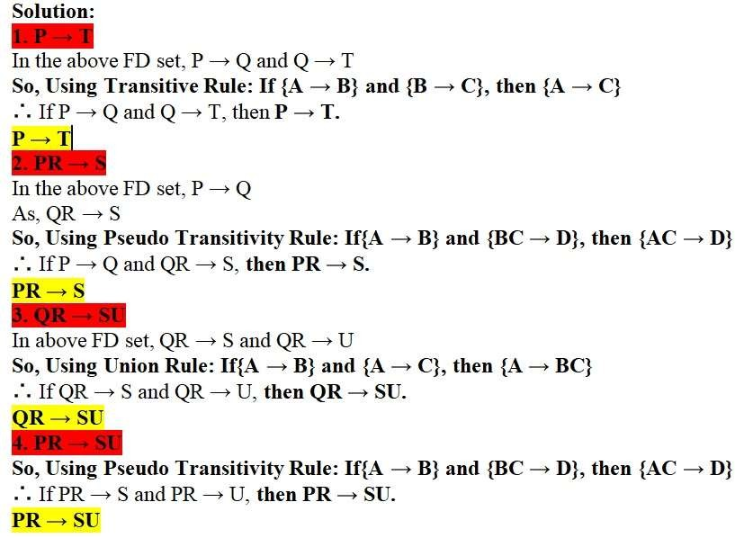
Example: Armstrong’s

Slide 26
Logical Implication
Given a relation schema R and a set of functional dependencies F. Let FD X→Y is not in F. F can be said to logically imply X→Y if for every relation r on the relation schema R that satisfies the FD in F, the relation r also satisfies X→Y
F logically implies X→Y is written as: F|=X→Y
Let R = (A, B, C, D) and F = {A→B, A→C, BC→D}
F|=A→D
Given F = {A→B, C→D} with C⊆B, show that F|=A→D

Slide 27
Closure/Closure on a attribute Set/ Closure of Attribute Set
Attribute Closure of an attribute set 'A' can be defined as a set of attributes which can be functionally defined from it.
Denoted by F^{+.}
Closure set means directly or indirectly which attribute we found.
Examples: 1
R(A,B,C) (A-> B, B->C)
Find (A)+ ?
Ans :
(A)+ = A
= AB (A-> B)
= ABC ( A -> C)

Slide 28
Closure of a Set of Functional Dependencies
Example-2
R(ABCDEF)
{ A- > B , C-> DE, AC ->F, D ->AF, E ->CF}
Find (D)⁺ and (DE) ^{+ ?}
Ans : (D)⁺ = D
=ADF
= ABDF
(D->AF)
( A->B)
(DE) ⁺ = DE
= ADEF
= ACDEF
= ABCDEF
(D-> AF)
(E-> CF)
(A->B)

Slide 29
Closure of a Set of Functional Dependencies
Given a set F of functional dependencies for a relation schema R, we define F +, the closure of F, to be the set of all functional dependencies that are logically implied by F. Mathematically,
F ={X→Y/F|=X→Y}
To generate all FDs that can be derived from F, the steps are:
First, apply the inference axioms to all single attributes and use the FDs of F whenever it is applicable
Second, apply the inference axioms to all combinations of two attributes and use the functional dependencies of F whenever it is applicable
Next apply the inference axioms to all combinations of three attributes and use the FDs of F when necessary
Proceed in this manner for as many different attributes as there are in F

Slide 30
Closure of a Set of Functional Dependencies
Let R=(A, B, C) and F={A→B, A→C}
F + = {A→A, B→B, C→C, A→B, A→C, A→BC, A→AB, A→AC, AB→A, AB→B, AB→AB, AC→A, AC→C, AC→AC, BC→B, BC→C, BC→BC, ABC→AB, ABC→AC, ABC→BC, ABC→ABC}
Let R=(W, X, Y) and F={W→X, X→Y, W→XY}
Uses of set of Functional Dependency Closure:
Computing if two sets of functional dependencies F and G are equivalent : When F +=G+, then the functional dependencies sets F and G are equivalent F={W→X, X→Y, W→XY} and G= {W→X, W→Y, X→Y}

Slide 31
Closure of a Set of Attributes
Given a set of attributes X and a set of functional dependencies F, then the closure of the set of attributes X under F, denoted as X +, is the set of attributes A that can be derived from X by applying the Armstrong’s Inference Axioms to the functional dependencies of F.
The closure of X is always a non empty set.
R = (A, B, C, D) and F = {A→C, B→D}
{A}+ = {A, C}, {B}+ = {B, D}, {C}+={C}, {D}+={D},
{A, B}+ = {A, B, C, D}, {A, C}+ = {A, C}, {A, D}+ = {A, C, D},
{B, C}+ = {B, C, D}, {B, D}+ = {B, D}, {C, D}+ = {C, D},
{A, B, C}+ = {A, B, C, D}, {A, B, D}+ = {A, B, C, D},
{B, C, D}+ = {B, C, D}, {A, B, C, D}+ = {A, B, C, D}
R = (X, Y, Z) and F = {X→Y, Y→Z}

Slide 32
Closure of a Set of Attributes
Uses of Attribute Closure:
Testing for key : To test whether X is a key or not, X + is computed. X is a key iff X + contains all the attributes of R. X is a candidate key if none of its subsets is a key
Testing functional dependencies: To check whether a functional dependency X→Y holds or not, just check if Y⊆ X +
Q - Given R=(A, B, C, D) and F={AB→C, B→D, D→B}, find the candidate keys of the relation. How many candidate keys are in this relation?

Slide 33
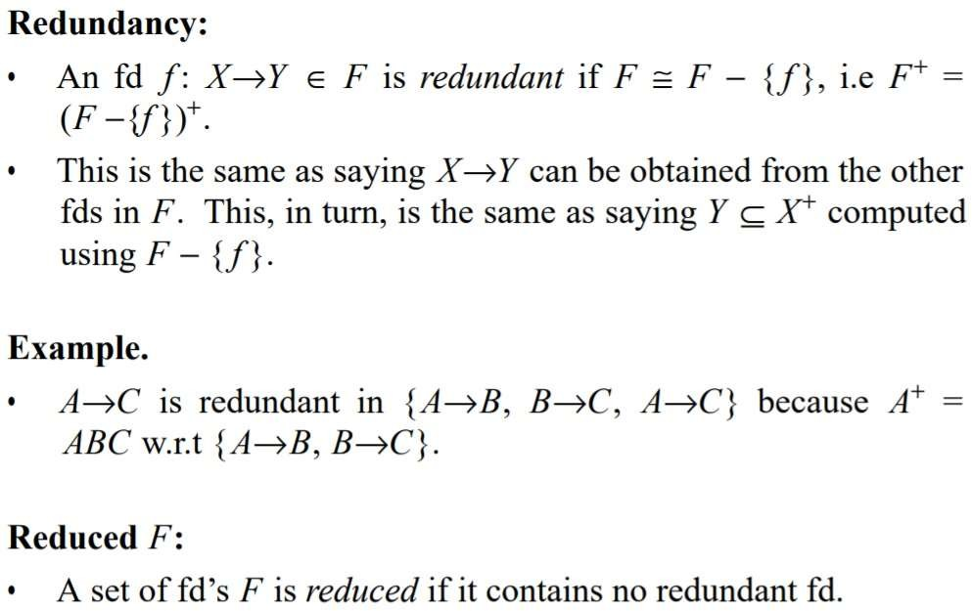
Redundant functional Dependencies

Slide 34
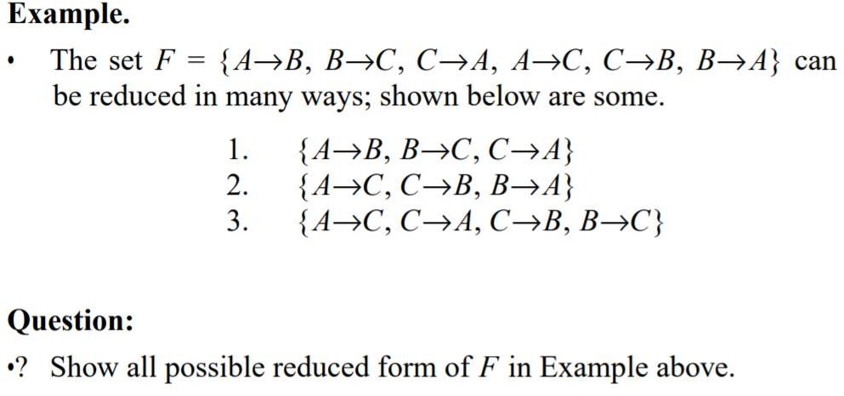
Redundant functional Dependencies

Slide 35
Redundant functional Dependencies (other way to find out)
A functional dependency in the set is redundant if it can be derived from the other functional dependencies in the set. A redundant FD can be detected using the following steps:
Step 1: Start with a set of S of functional dependencies (FDs).
Step 2: Remove an FD f and create a set of FDs S' = S - f .
Step 3: Test whether f can be derived from the FDs in S'; by using the set of Armstrong's axioms and derived rules.
Step 4: If f can be so derived, it is redundant , and hence S' = S. Otherwise replace f into S'; so that now S' = S + f.
Step 5: Repeat steps 2 to 4 for all FDs in S.
Armstrong's axioms and derived rules, as discussed in the previous section, can be used to find redundant FDs.

Slide 36
Example
For example, suppose the following set of FDs is given in the algorithm:
Z -> A B -> X AX -> Y
ZB -> Y
Because ZB -> Y Can be derived from other FDs in the set, it can be shown to be redundant.
The following argument can be given:
Z -> A by augmentation rule will yield ZB -> AB.
B -> X and AX -> Y by pseudo-transitivity rule will yield AB -> Y.
ZB -> AB and AB -> Y by transitivity rule will yield ZB -> Y.

Slide 37
Canonical Cover / Minimal Cover
Canonical Cover / Minimal Cover: For a given set F of FDs, a canonical cover, denoted by Fc , is a set of FDs where the following conditions are satisfied:
F and Fc are equivalent
Every FD of Fc is simple. That is, the RHS of every functional dependency of Fc has only one attribute
No FD in Fc is redundant
The determinant or LHS of every FD in Fc is irreducible
R = (A, B, C) and F = {A→{B, C}, B→C, A→B, {A, B}→C}
Fc = {A→B, B→C}
As canonical cover contains the functional dependencies without any redundancy, therefore finding the key of the relation becomes efficient.

Slide 38
Canonical Cover / Minimal Cover
Sometimes Functional Dependency Sets are not able to reduce if the set has following properties,
The Right-hand side set of functional dependency holds only one attribute.
The Left-hand side set of functional dependency cannot be reduced, it changes the entire content of the set.
Reducing any functional dependency may change the content of the set.
A set of functional dependencies with the above three properties are also called as Canonical or Minimal.

Slide 39
Canonical Cover / Minimal Cover
Whenever a user updates the database, the system must check whether any of the functional dependencies are getting violated in this process. If there is a violation of dependencies in the new database state, the system must roll back. Working with a huge set of functional dependencies can cause unnecessary added computational time. This is where the canonical cover comes into play.
A canonical cover of a set of functional dependencies F is a simplified set of functional dependencies that has the same closure as the original set F.
Extraneous attributes: An attribute of a functional dependency is said to be extraneous if we can remove it without changing the closure of the set of functional dependencies.

Slide 40
Canonical Cover / Minimal Cover/Irreducibe set of FD
Example R(WXYZ) X-> W
WZ ->XY Y->WXZ
Find the canonical Cover or Minimal Comer.
Ans:
Step-1: The right side should contain single attribute. X->W
WZ->X
WZ->Y Y->W Y->X
Y->Z

Slide 41
Canonical Cover / Minimal Cover/Irreducibe set of FD
Step-2 : Find out Closure
X->W
X⁺ = XW
X ⁺ = X ( we getting different value in the second time of X closure after hiding X- W so X->W is essetial.)
WZ->X , WZ-> Y
(WZ)⁺ = WZXY
(WZ)⁺ = WZXY (In sexond time we are getting the same valuse so WZ-> X is not essetial , so remove from list)
(WZ)+= WZ
Y->W, Y->X,Y->Z
Y⁺ = YZXZ
Y⁺= YXZW (Y->W is not essetialk so remove from list)
Y⁺=YZ
Y⁺=YXW

Slide 42
Canonical Cover / Minimal Cover/Irreducibe set of FD
Step-3:
Y->W WZ->Y Y->X
Y->Z
Step-4 (Checl left side double attribute value ) (WX)⁺= WZYX
W⁺= W Z⁺= Z
So, WZ-> Y is essetial.
Step-5: Union Y->W
WZ->Y Y->XZ

Slide 43
Normalization
Normalization is the process of decomposing or breaking a relation schema R into fragments (i.e. smaller schemas) R1, R2, ... Rn such that the following conditions hold:
Lossless decomposition: The fragments should contain the same information as the original relation
Dependency preservation: All the functional dependencies should be preserved within each fragment Ri
Good form: Each fragment Ri should be free from any type of redundancy
In other words, normalization is the process of refining the relational data model. It is used because of the following reasons:
It improves database design
It ensures minimum redundancy of data
It removes anomalies for database activities

Slide 44
Decomposition
What is Decomposition?
Decomposition is the process of breaking down in parts or elements.
It replaces a relation with a collection of smaller relations.
It breaks the table into multiple tables in a database.
It should always be lossless, because it confirms that the information in the original relation can be accurately reconstructed based on the decomposed relations.
If there is no proper decomposition of the relation, then it may lead to problems like loss of information.
Following are the properties of Decomposition,
Lossless Decomposition
Dependency Preservation
Lack of Data Redundancy

Slide 45
Lossless Decomposition
Lossless Decomposition
Decomposition must be lossless. It means that the information should not get lost from the relation that is decomposed.
It gives a guarantee that the join will result in the same relation as it was decomposed.
Example:
Let's take 'E' is the Relational Schema, With instance 'e'; is decomposed into: E1, E2, E3, . . . . En; With instance: e1, e2, e3, . . . . en, If e1 ⋈ e2 ⋈ e3 . . . . ⋈ en, then it is called as 'Lossless Join Decomposition'.

Slide 46
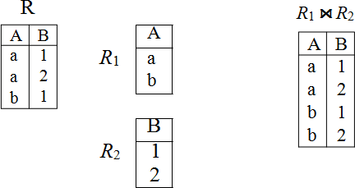
Lossless Decomposition
The decomposition of a base relation is said to be lossless if the original relation can be recovered back by joining the fragment relations
Let R be the base relation, which is decomposed into R1, R2, ... Rn . This decomposition is lossless iff R= R1 ⋈ R2 ⋈... ⋈ Rn . In other words, the consecutive fragments are interrelated by the primary key and foreign key relationships.
Fig 2
R
R1 ⋈ R2
A | B
a | 1
a | 2
b | 1
b | 2
A | B
a b | 1 2
A | B
a | 1
a | 2
b | 1
b | 2
Fig 1
In Fig.1, as R1 ⋈ R2 = R, the decomposition is lossless.
In Fig.2, as R1 ⋈ R2 ! = R, the decomposition is lossy.

Slide 47
Lossless Decomposition...
When the base relation schema is decomposed into the fragmented relation schemas, the consecutive relations should be related by primary key - foreign key pair on the common column; so that natural join be possible on the common column. Thus, we have to check whether the common column is the key of any relation or not:
If the common column is the key, the decomposition is lossless
If the common column is not the key, the decomposition is lossy

Slide 48
Lossless Decomposition...
Rules/Property : This property guarantee that the extra tuple generation problem doesnot occur after decomposition.
It is mandatory property must always holds good.
If a relation R is decomposed in to two relations R1 and R2 ,then it will be lossless iff:
attribute (R1) U attribute (R2) = attribute (R)
attribute(R1) Ʌ attribute (R2) != ɸ
attribute(R1) Ʌ attribute (R2) -> attribute(R1)
or
attribute(R1) Ʌ attribute (R2) -> attribute(R2)

Slide 49
Lossless Decomposition(Examples)
A | B | C | D
1 | a | p | x
2 | b | q | y
A | B
1 | a
2 | b
C | D
p | x
q | y
R1 x R2 we gor more extra tuple . so it is not same as orogina table
A | B | C | D
1 | a | p | x
1 | a | q | y
2 | b | p | x
2 | b | q | y

Slide 50
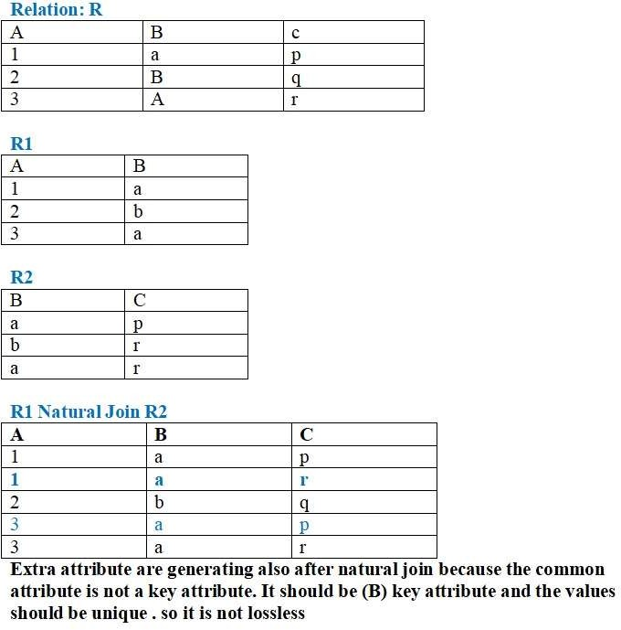
Lossless Decomposition...

Slide 51
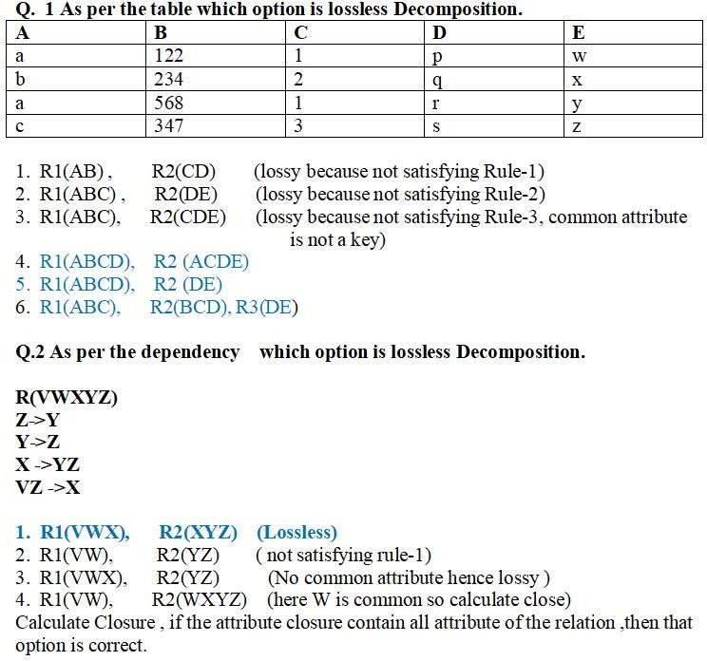
Lossless Decomposition...

Slide 52
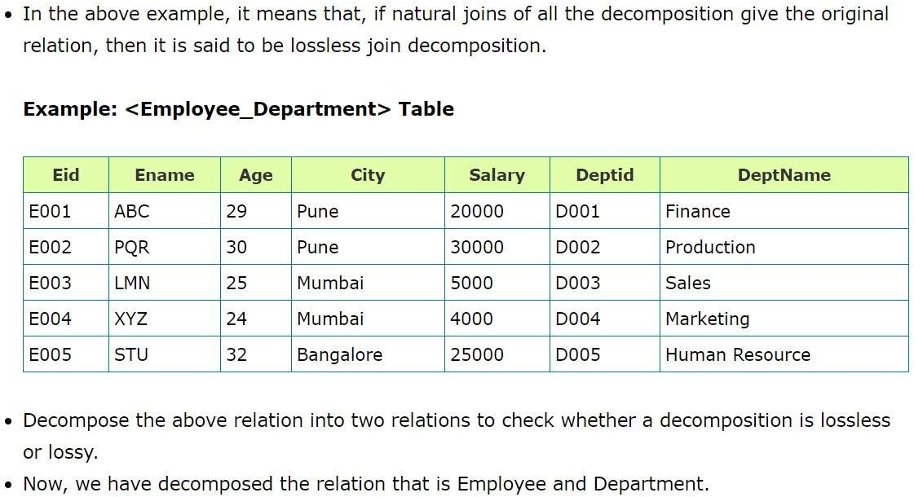
Lossless Decomposition...

Slide 53
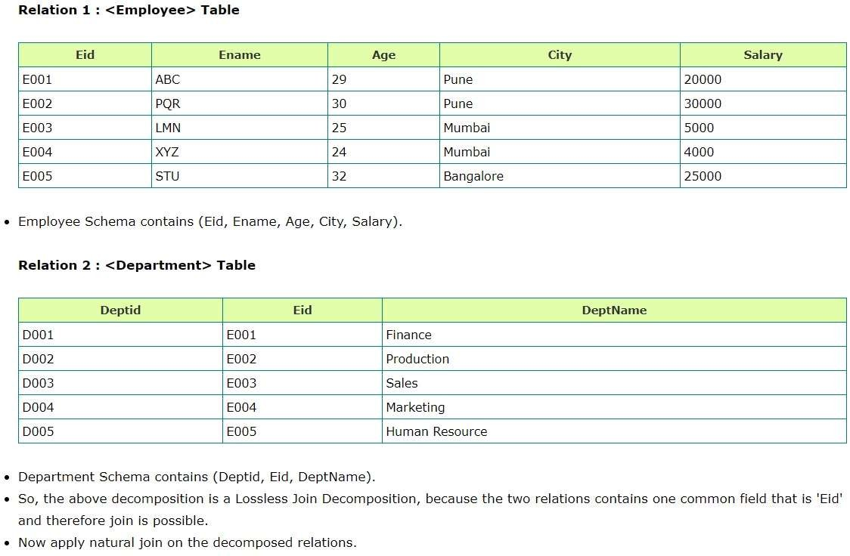
Lossless Decomposition...

Slide 54
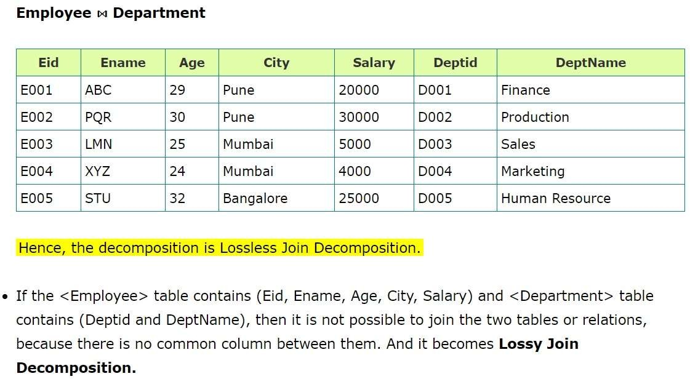
Lossless Decomposition...

Slide 55
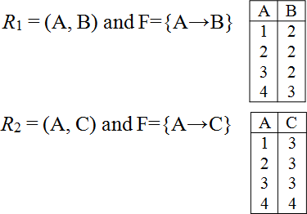
Dependency Preservation
The decomposition of a relation schema R with FDs F is a set of fragment relations Ri with FDs Fi , where Fi is the subset of dependencies in F + that include only attributes in Ri . The decomposition is dependency preserving if
and only if
R
(𝖴i Fi )+ = F +
R = (A, B, C) and F={A→B, B→C, A→C}, Key=A.
Here, Key=A
The decomposition is lossless
because R1 ⋈ R2 = R
But, the decomposition is not dependency preserving because
(F1 𝖴 F2)⁺={A→B, A→C}
A | B | C
1 | 2 | 3
2 | 2 | 3
3 | 2 | 3
4 | 3 | 4
! _{= F}+
Thus, (F1 𝖴 F2)⁺ as we
lost the FD B→C.

Slide 56
Guidelines followed in Designing Good Database
Guideline 1: Design a relation schema so that it is easy to explain its meaning. Do not combine attributes from multiple entity sets and relationship sets into a single relation.
If a relation schema corresponds to one entity set or one relationship set, then the meaning tends to be simple and clear. Otherwise, the relation corresponds to a mixture of multiple entities and relationships and hence becomes complex and unclear.
Only foreign keys should be used to refer to other entities. Entity and relationship attributes should be kept apart as much as possible.
Bottom Line: design the schemas that can be explained easily relation by relation. In such cases, the semantics of attributes should be easy to interpret.
Guideline 2: Design the base relation schemas in such a way that the anomalies such as insertion, deletion, or updation anomalies are removed from the relations
If any anomalies are present, note them clearly and make sure that the programs that modify (update) the database will operate correctly.

Slide 57
Guidelines followed in Designing Good Database
Guideline 3: Avoid placing attributes in a base relation whose values may frequently be NULL
If NULLs are unavoidable, make sure that they apply in exceptional cases
only and do not apply to a majority of tuples in the relation.
Attributes that are NULL frequently could be placed in separate relations (with the primary key).
Guideline 4: Design the relation schemas so that they can be joined in such a way that no spurious tuples are generated
Avoid relations that contain matching attributes that are not (foreign key and primary key) combinations, because joining on such attributes may produce spurious tuples.

Slide 58
Normalization
1NF
a relation in BCNF, is also in 3NF
a relation in 3NF is also in 2NF
a relation in 2NF is also in 1NF
2NF
3NF
BCNF

Slide 59
Normal Forms
Normal forms
It provides a stepwise progression towards the construction of normalized relation schemas, which are free from data redundancies.
A relation schema is said to be in a particular normal form if it is satisfying certain defined conditions.
The objective of normalization:
“to create relations where every dependency is on the key, the whole key, and nothing but the key”.
First Normal Form (1NF)
A relation will be 1NF if it contains an atomic value.
It states that an attribute of a table cannot hold multiple values. It must hold only single-valued attribute.
First normal form disallows the multi-valued attribute, composite attribute, and their combinations.
Example: Relation EMPLOYEE is not in 1NF because of multi-valued attribute EMP_PHONE.

Slide 60
Normal Forms
Id No | Name | DOB | Subject | Grade
960100 | Ram | 14/11/77 | Data Base, Soft Engg,ISDE | C A B
960105 | Rishi | 10/05/75 | Soft Engg ISDE | B B
960120 | Abhi | 1/03/70 | BDMS Soft Engg Workshop | A B C
96015 | Ram | 09/01/72 | DBMS | B
960150 | VIKASH | 21/01/73 | DBMS SOFT ENGGISDE WORKSHOP | D B C D
In the above table subject and grade are known as repeating groups. They have more than one value for each student . The problem arises because each student will study a number of subjects and we need to store their marks in each subject. We have solved the problem by putting those repeating values in to a single cell.

Slide 61
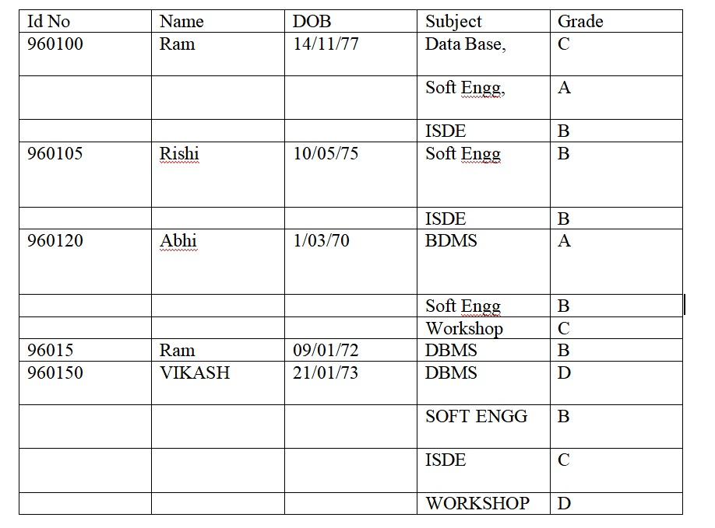
First Normal Form (1NF)
Solving the repeated values

Slide 62
First Normal Form (1NF)
In order to store it as a relational database we must the data into INF i.e. we remove the repeating groups . By two ways we can solve the problem.
1. Flattern the table and Change the Key
2. Decompostion the relation.
1. Flattern the table and Change the Key
As we can only guess with student has got an A grade in soft Engg in line -2 . We cannot access the data where the primary Key. This cannot be left in the present state because the id-no which is the primary key has blank values it it. This is not allowed so, the next stage is to fill i blanks. we can simple copy down the data and fill in the id-no, name, and DOB fields.
Although it is an improvment , we are facing another problem, i.e the id-no no longer a promary key. so we have to choose a new primary key .In the below table id-No and Subject is the new primary Key

Slide 63
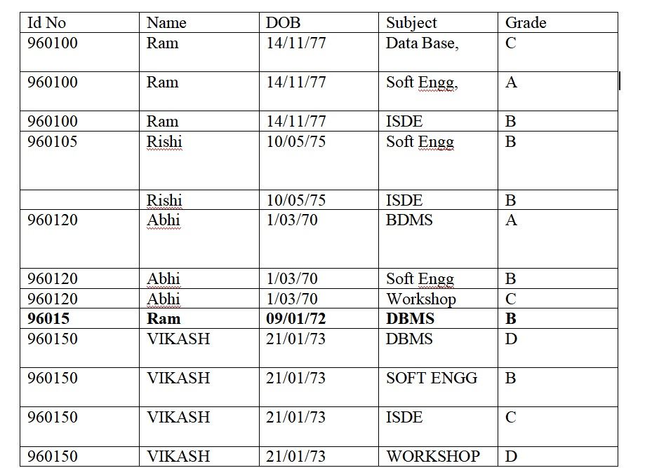
First Normal Form (1NF)

Slide 64

Normal Forms
2. Decompostion the relation.
The alternative approach is to split the table in to two parts. One part for repeating groups and another is for non repeating groups.
The primary key of the original relation sholud be included in both the relations.

Slide 65
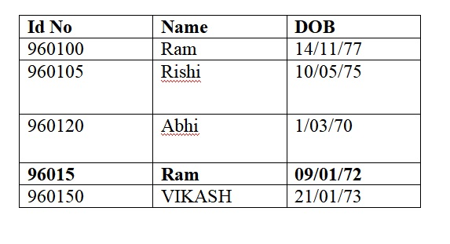
First Normal Form (1NF)

Slide 66
Partial FD
A FD A → B is a partial FD, if some attribute of A can be removed and the FD still holds. That means there is some proper subset of A, C ⊂ A, such that C → B
Key attributes(prime attributes): are the attributes which are part of some candidate key
Non-key attributes(non-prime attibutes): are the attributes which are not part of any candidate key
What is Partial Dependency in DBMS?
Ans: The FD (functional dependency) A->B happens to be a partial dependency if B is functionally dependent on A, and also B can be determined by any other proper subset of A. For instance, we have a relationship like MO->N, M->P, and P->N.

Slide 67
Partial dependency
A partial dependency exists when an attribute B is functionally dependent on an attribute A, and A is a component of a multipart candidate key.
InvNum
LineNum
Qty
InvDate
Candidate keys: {InvNum, LineNum} InvDate is partially dependent on {InvNum, LineNum} as InvNum is a determinant of InvDate and InvNum is part of a candidate key

Slide 68
2NF (Second Normal Form)
A relation is in 2NF iff the following two conditions are met simultaneously:
It is in 1NF
No non-key attribute is partially dependent on any key
To be in second normal form, a relation must be in first normal form and relation must not contain any partial dependency.
A relation is in 2NF iff it has No Partial Dependency, i.e., no non-prime attribute (attributes which are not part of any candidate key) is dependent on any proper subset of any candidate key of the table.
Partial Dependency – If proper subset of candidate key determines non-prime attribute, it is called partial dependency.

Slide 69
2NF (Second Normal Form)
Example 1 – In relation STUDENT_COURSE given in Table 3 ,
FD set: {COURSE_NO->COURSE_NAME}
Candidate Key: {STUD_NO, COURSE_NO}
•
In FD COURSE_NO->COURSE_NAME, COURSE_NO (proper subset of candidate key) is determining COURSE_NAME (non-prime attribute). Hence, it is partial dependency and relation is not in second normal form.
To convert it to second normal form, we will decompose the relation STUDENT_COURSE (STUD_NO, COURSE_NO, COURSE_NAME) as :
•
STUDENT_COURSE (STUD_NO, COURSE_NO)
COURSE (COURSE_NO, COURSE_NAME)

Slide 70
2NF (Second Normal Form)
Example 2 – Consider following functional dependencies in relation R (A, B , C, D )
AB -> C [A and B together determine C]
BC -> D [B and C together determine D]
In the above relation, AB is the only candidate key and there is no partial dependency, i.e., any proper subset of AB doesn’t determine any non-prime attribute.

Slide 71
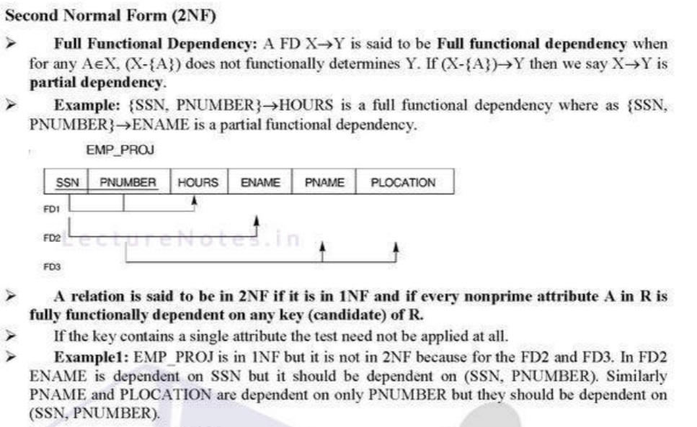
2NF (Second Normal Form)

Slide 72
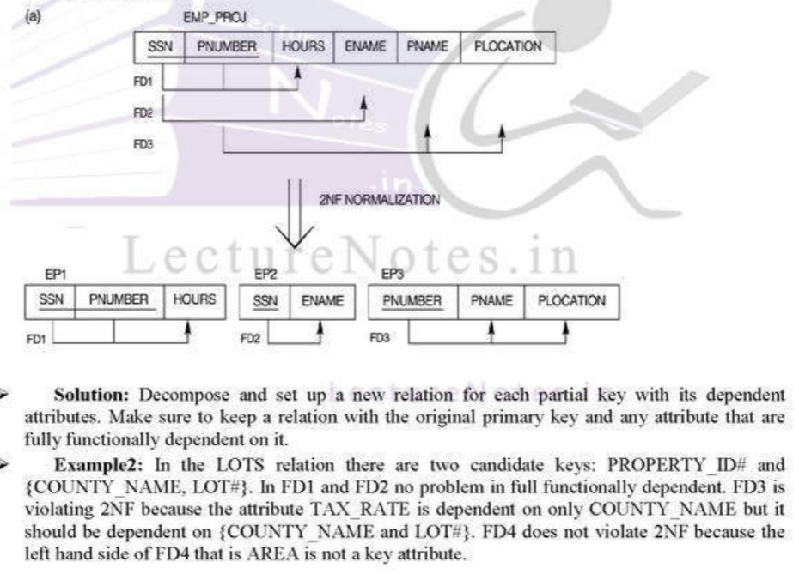
2NF (Second Normal Form)

Slide 73
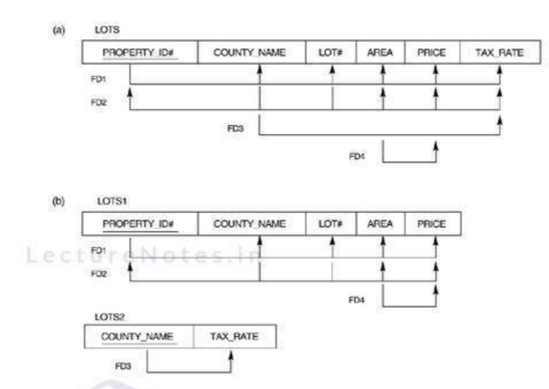
2NF (Second Normal Form)

Slide 74
Transitive dependency
EmpNum → DeptNum
EmpNum EmpEmail DeptNum DeptNname
DeptNum → DeptName
EmpNum EmpEmail DeptNum DeptNname
DeptName is transitively dependent on EmpNum via DeptNum
EmpNum → DeptName

Slide 75
3NF (Third Normal Form)
Def: A relation is in 3NF if it satisfies 2NF and no non-prime attribute of R is tranisitively dependent on Key of R.
or
A relation is in 3NF if FD 'X->Y' satify any of the following conditions.
X->Y is a trivial FD i.e Y⊂= X
If X ->Y, then X is a super key.
If X->Y , then (Y-X) is a prime attribute. (attribute prese)
Example :
C- > D
x ->y
i.e Y-X= D-C=D So it is 3NF

Slide 76
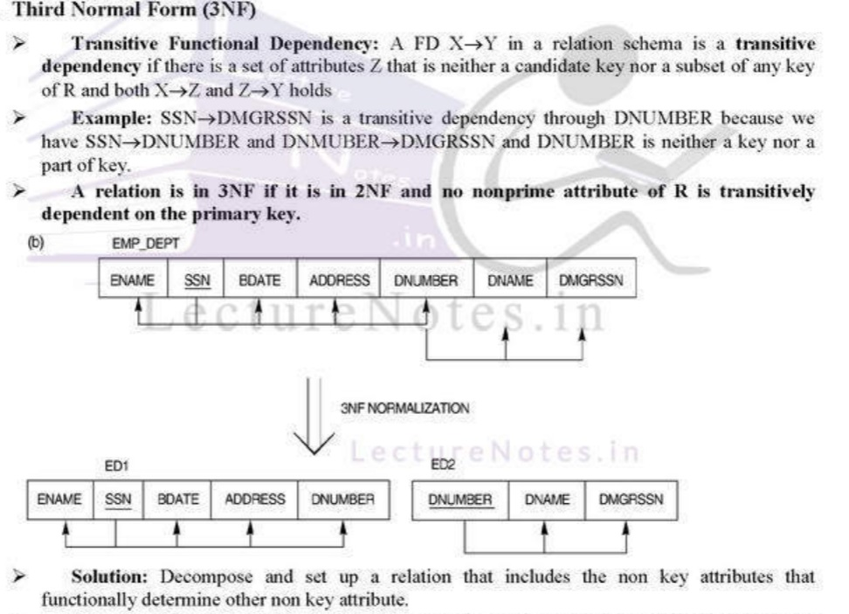
3NF (Third Normal Form)

Slide 77
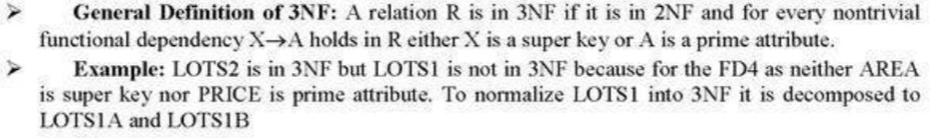
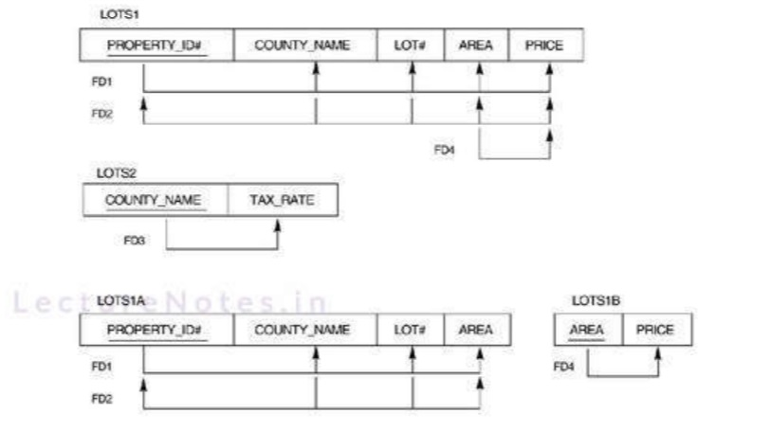
3NF (Third Normal Form)

Slide 78
Questions
Q1 - R(ABCD)
FD = {AB->C, C->D}
Q2 - R(ABCD)
FD = {AB->CD, D->A}
(TD - if a non-prime attribute is determining non prime attribute)
(either L.H.S should be a CK or SK or R.H.S should be a prime attribute)

Slide 79
Boyce-codd Normal Form(BCNF)
It is extension of 3NF on strict terms.
A relation is in BCNF if atleast one of the condtion holds .
X->Y is a trivila FD
X->Y , then X is a super key.
Every BCNF is a 3NF but vice-versa is not true
Any relational schema with only two attributes is automatically in BCNF.
Example:1 R is in 3NF OR BCNF ?
R(ABC)
FD: {AB->C, C->A}
Ans:
(AB)+ = ABC, (BC)+ = BCA
so Candidate Key: Ab and BC
AB->C (BCNF)
C-> A (is 3NF but not in BCNF)

Slide 80
Boyce-codd Normal Form(BCNF)
Example-2
R(ABCDEFGHIJ)
FD: {AB->C, A->DE, B->F, F->GH, D->IJ}
Decompose it into BCNF
Ans:
Candidate Key check
(AB)+ = ABCDEFGHIJ
so Candidate Key= AB
AB-> C (BCNF)
R1(ABC) R2(DEFGHIJ)
AB->C F->GH, D->IJ
(continute this process by calculatig key that every id left hand side is super key)

Slide 81
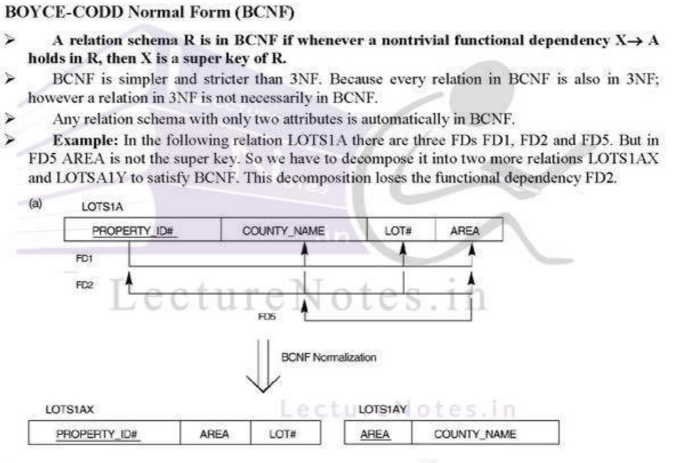
BCNF (Boyce-Codd Normal Form)

Slide 82
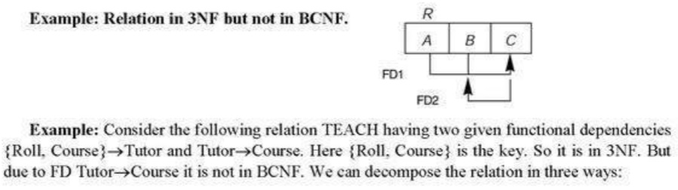
BCNF (Boyce-Codd Normal Form)

Slide 83
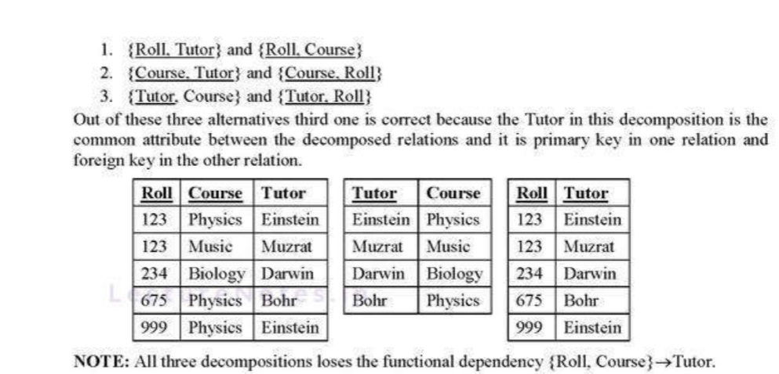
BCNF (Boyce-Codd Normal Form)

Slide 84
BCNF (Boyce-Codd Normal Form)
Q. BCNF is a stronger form of normalization than 3NF. Justify. (2 marks)
Ans: 3NF (citing from head so forgive slight wording inaccuracies) requires that every non-key attribute is fully and non-transitively dependent on each candidate key. There is no such requirement for key attributes.
BCNF requires that every attribute is fully and non-transitively dependent on each candidate key. Which can also be phrased as: satisfies 3NF and in addition also requires that every key attribute is fully and non-transitively dependent on each candidate key.
The above means that every BCNF relation is also 3NF, but every 3NF relation is not necessarily BCNF. Hence BCNF is stronger than 3NF.

Slide 85
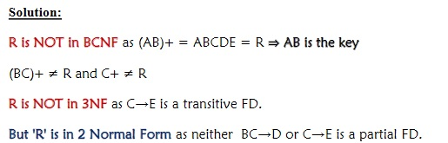
BCNF (Boyce-Codd Normal Form)
Find the highest normal form of given relation schema R(A,B,C,D,E) with set of functional dependencies, F = {AB→CE, BC→D, C→E}.

Slide 86
BCNF (Boyce-Codd Normal Form)
Q. BCNF is a stronger form of normalization than 3NF. Justify. (2 marks)
Ans: 3NF (citing from head so forgive slight wording inaccuracies) requires that every non-key attribute is fully and non-transitively dependent on each candidate key. There is no such requirement for key attributes.
BCNF requires that every attribute is fully and non-transitively dependent on each candidate key. Which can also be phrased as: satisfies 3NF and in addition also requires that every key attribute is fully and non-transitively dependent on each candidate key.
The above means that every BCNF relation is also 3NF, but every 3NF relation is not necessarily BCNF. Hence BCNF is stronger than 3NF

Slide 87
Example
Let R = (A, B, C, D, E) be a given relation schema with functional dependencies, F = {CE → D,D → B,C → A}.
(1+ 2+ 3 = 6 marks)
Find all candidate keys.
Check whether R is in BCNF or not?
If R is not in BCNF, then do the BCNF decomposition and check whether the decomposition is lossless and dependency preserving decomposition or not??

Slide 88
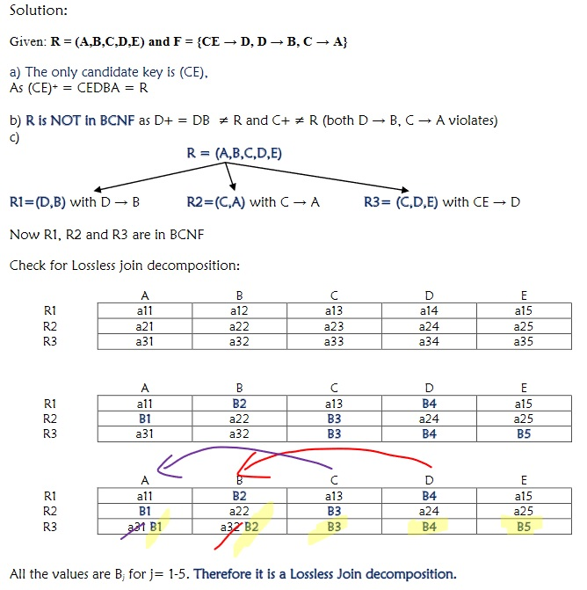
Example

Slide 89
MVD (Multi-Valued Dependency)
A table involves a multi-valued dependency if it may contain multiple values for an entity
A multi-valued dependency A →→ B exists iff for every occurrence of A; there exists multiple occurrences of B
If A →→ B and A →→ C, then we have a single attribute A which multi-determines two other attributes, B and C
Multi-valued dependencies are also referred to as tuple generating dependencies
An MVD X →→ Y in relation R is called a trivial MVD if:
Y is a subset of X, or
X ∪ Y = R
An MVD that satisfies neither the first nor the second condition is called a nontrivial MVD.
Normally, MVDs exist in pair.

Slide 90
MVD (Multi-Valued Dependency)
Important Points:
There must be 3 or more attributes .
Attributes must be independent with each other.
FD (α →β ) says we cannot have two tuples with same α value but different β value.

Slide 91
MVD (Multi-Valued Dependency)
Person(P) | Mobile(M) | Food_like(F)
P1 | M1, M2 | F1, F2
P2 | M3 | F2
Person(P) | Mobile(M) | Food_like(F)
P1 | M1 | F1
P1 | M2 | F2
P1 | M1 | F2
P1 | M2 | F1
P2 | M3 | F2
In the avove table P→→M, P→→F

Slide 92
MVD (Multi-Valued Dependency)
MVDs are: Name →→ Project and Name →→ Hobby
Employee
Name | Project | Hobby
Asis Asis Asis Asis Bikash Bikash Bikash Bikash | Microsoft Oracle Microsoft Oracle Intel Sybase Intel Sybase | Reading Music Music Reading Movies Riding Riding Movies

Slide 93
4NF (Fourth Normal Form)
A relation is in 4NF iff the following two conditions are satisfied simultaneously:
It is in 3NF
It contains no multiple MVDs
In other words, a relation is in 4NF iff:
There are no nontrivial MVDs in the relation, or
The determinant of any nontrivial MVD in the relation is a key
The previous relation is not in 4NF.
Name | Hobby
Asis Asis Bikash Bikash | Oracle Oracle Intel Sybase
Employee_Project
Name →→ Project
Name | Hobby
Asis Asis Bikash Bikash | Reading Music Riding Movies
Employee_Hobby
Name →→ Hobby
These relations are present in 4NF because the MVDs are

Slide 94
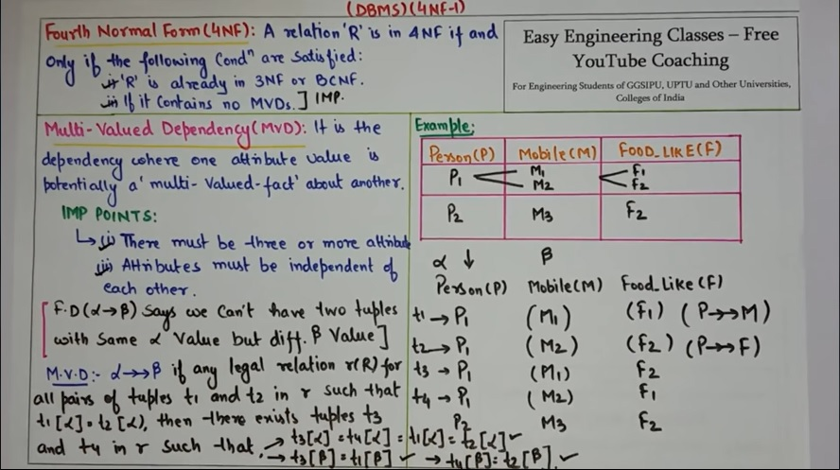
4NF- Example

Slide 95
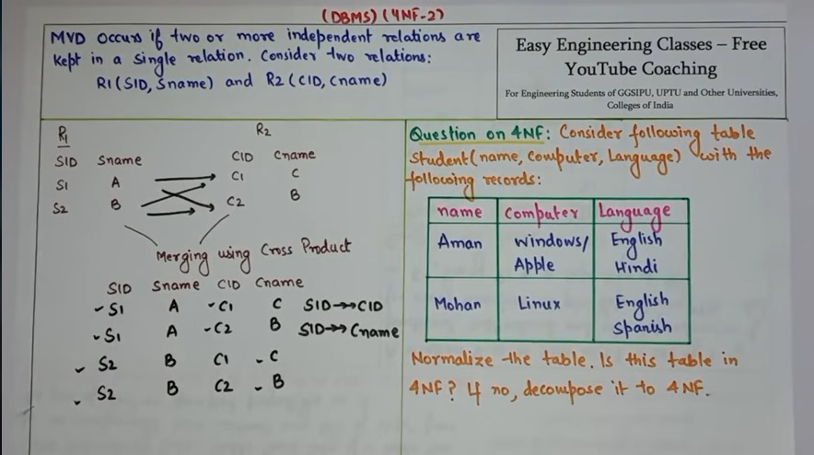
4NF- Example

Slide 96
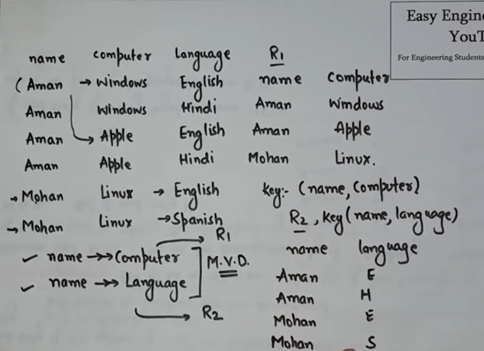
J4NF- Example

Slide 97
JD (Join Dependency)
A relation R satisfies join dependency (R1, R2 ... Rn ) iff:
R is equal to the join of R1, R2 ... Rn on the common attributes, where Ri is a subset of the relation R.
That means R satisfies join dependency iff R= R1 ⋈ R2 ⋈ ... Rn
In other words, a join dependency is said to hold over a relation R if R1, R2 ... Rn is a lossless-join decomposition of R.

Slide 98
JD (Join Dependency)
Join decomposition is a further generalization of Multivalued dependencies.
If the join of R1 and R2 over C is equal to relation R, then we can say that a join dependency (JD) exists.
Where R1 and R2 are the decompositions R1(A, B, C) and R2(C, D) of a given relations R (A, B, C, D).
Alternatively, R1 and R2 are a lossless decomposition of R.
A JD ⋈ {R1, R2,..., Rn} is said to hold over a relation R if R1, R2,....., Rn is a lossless-join decomposition.
The *(A, B, C, D), (C, D) will be a JD of R if the join of join's attribute is equal to the relation R.
Here, *(R1, R2, R3) is used to indicate that relation R1, R2, R3 and so on are a JD of R.

Slide 99
De-normalization
Advantages of normalization:
It removes data redundancy
It solves Insertion, Updation, and Deletion anomalies
This makes it easier to maintain in the database in a consistent state
Disadvantages of normalization:
It leads to more tables in the database
For retrieving the records or information, these tables need to be joined back together, which is an expensive task
Thus, sometimes it is worth de-normalizing.

Slide 100
De-normalization
Once a normalized database design has been achieved, adjustments can be made with the potential consequences (anomalies) in mind.
Possible de-normalization steps include the following:
Recombining relations that were split to satisfy normalization rules
Storing redundant data in tables
Storing summarized data in tables
De-normalization is the opposite of Normalization.
It is the process of increasing redundancy in the database either for convenience or to improve performance.

